Slide 1
CTR Predıctıon on KAGGLE Data
Rıdvan Salih Kuzu

Slide 2
DATA PREPARATION
The raw data is too large for processing on a standard computer, for that reason, a subsample of CTR rows (1% in this work) are randomly extracted at the beginning. The extraction is made by using following command:
cat train.csv | awk 'BEGIN {srand()} !/^$/ { if (rand() <= .01) print $0}' > train_subset
CTR data is parsed to 24 columns, after that HOUR data is split into DAY and HOUR columns. ID column is removed because it is not a feature to be used in modelling.
CLICK column is separated for model labelling
Categorical features are encoded due to the fact that they can be used with other numerical features together.
Finally data is randomly split into train, validation and test parts (70%-15%-15% division)

Slide 3
DEVELOPING AND VALIDATING MODEL
Train data is fitted with the standard scaler, after that test data is transformed by using scaling coefficients of train data.
False Discovery Rate (FDR) with highest p_value=0.05 is used to select discriminative features on train and test data.
7 different classification methods are selected to compare model performances and determining best model on them. These are:
Random Forest, Multilayer Perceptron, Logistic Regression, Linear Discriminant Analysis, KNN, Decision Tree, and Naïve Bayes
5-fold cross validation on train data is conducted in order to determine the model which gives the best accuracy.
Among these supervised learning methods, MLP gives the highest accuracy and the lowest logarithmic loss.
In order to determine the best method more precisely, grid search on each classifier by fine-tuning their hyper-parameters can be executed. Nevertheless, it took more than 1-day, and I decided to use each model with their default hyper-parameters. (Still, the code for grid search can be observed on my source-code).
At the end, the prediction model is fine-tuned on validation data and executed on test data by using Random Forest Classifier.

Slide 4
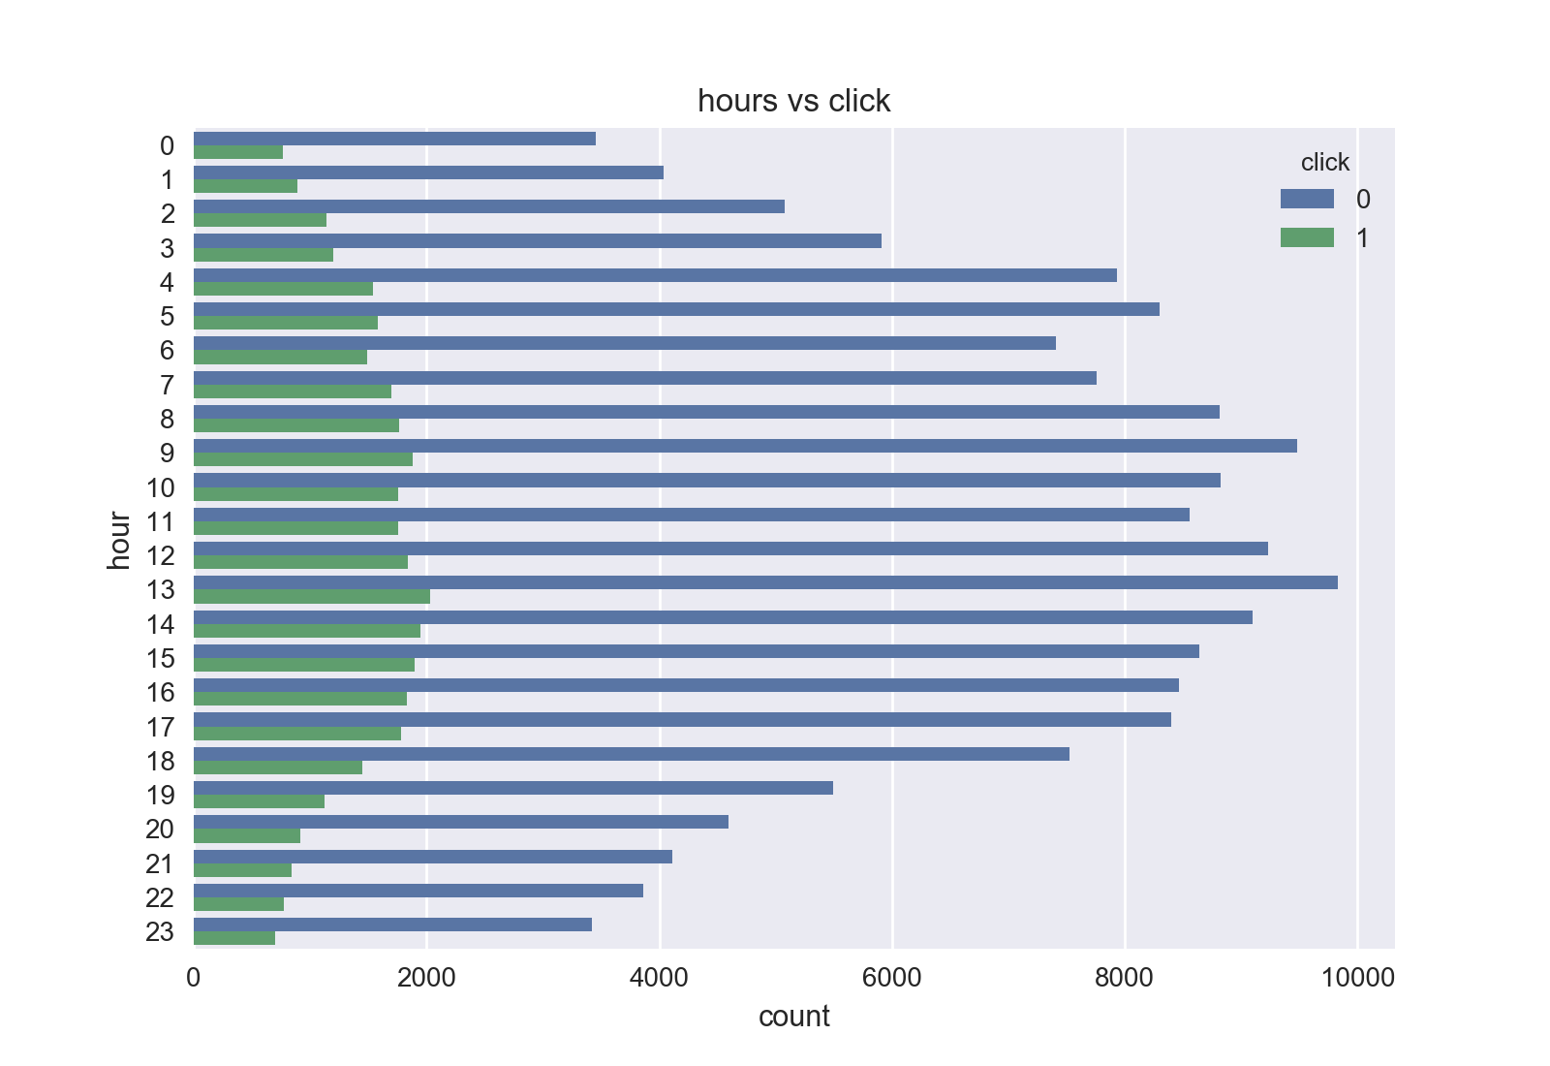
INTERPRETATION OF THE DATA OUTPUTS -1
People are more active in the middle of days.

Slide 5
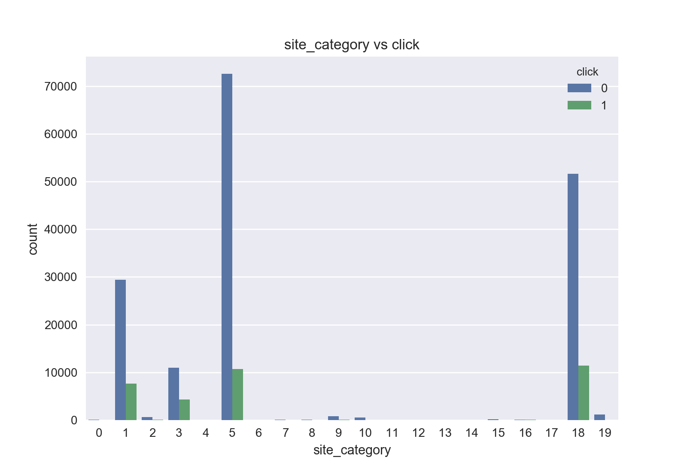
INTERPRETATION OF THE DATA OUTPUTS -2
Although number of click is highest on 18th site category, Click/Unclick rate of 3rd site category outperforms rest of categories’ performance

Slide 6
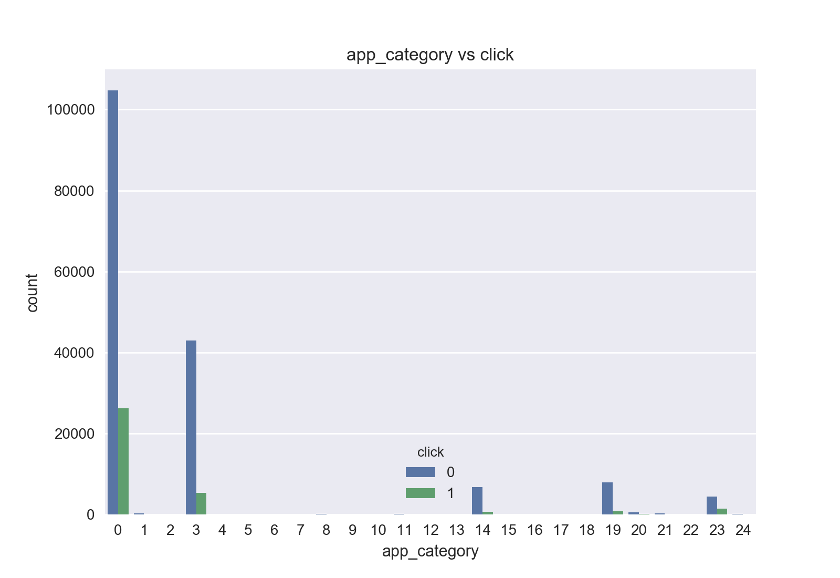
INTERPRETATION OF THE DATA OUTPUTS -3
Category 0 has the highest interaction with users, however best click/unclick rate is achieved by applications on the 23rd category.

Slide 7
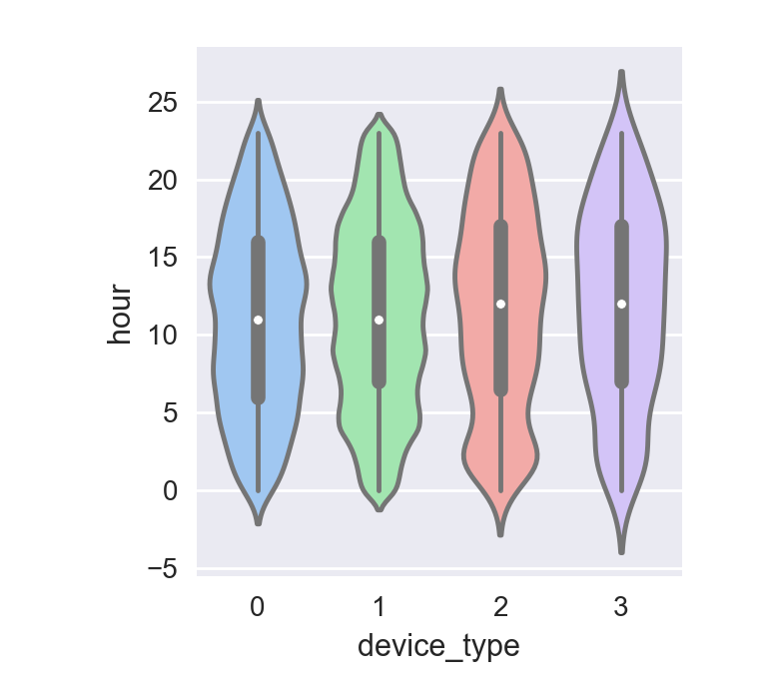
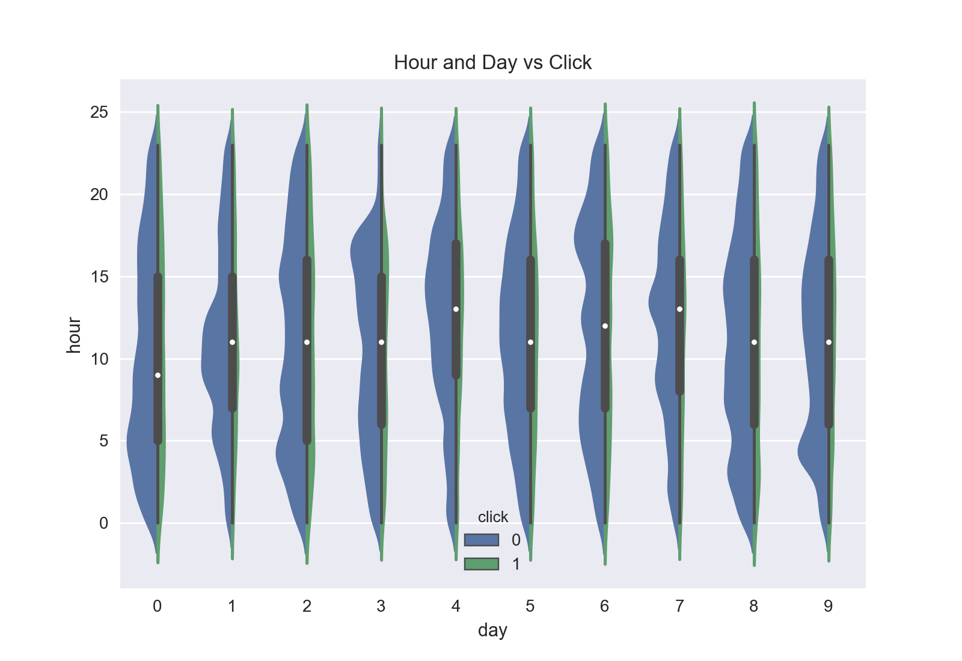
INTERPRETATION OF THE DATA OUTPUTS -4
Device 2 users are more active after midnight as shown on the left figure.
As shown on the right figure, On day 0, highest user interaction of midnights is achieved. On the other hand, the least midnight user interaction is confronted on day 4.

Slide 8
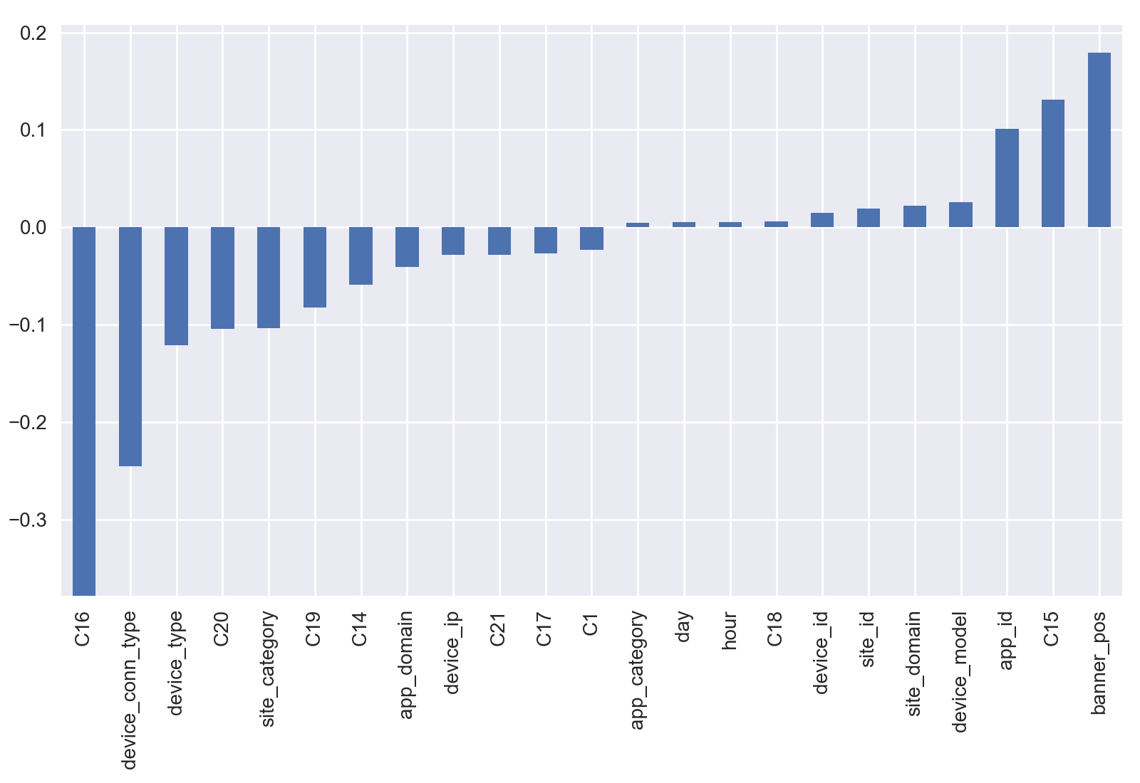
INTERPRETATION OF THE MODEL OUTPUTS-1
The features that seems to contribute most positively to get a click are banner position, C15, application id,
while the features that contribute most negatively are C16, device connection type, device type, C20 and site category.

Slide 9
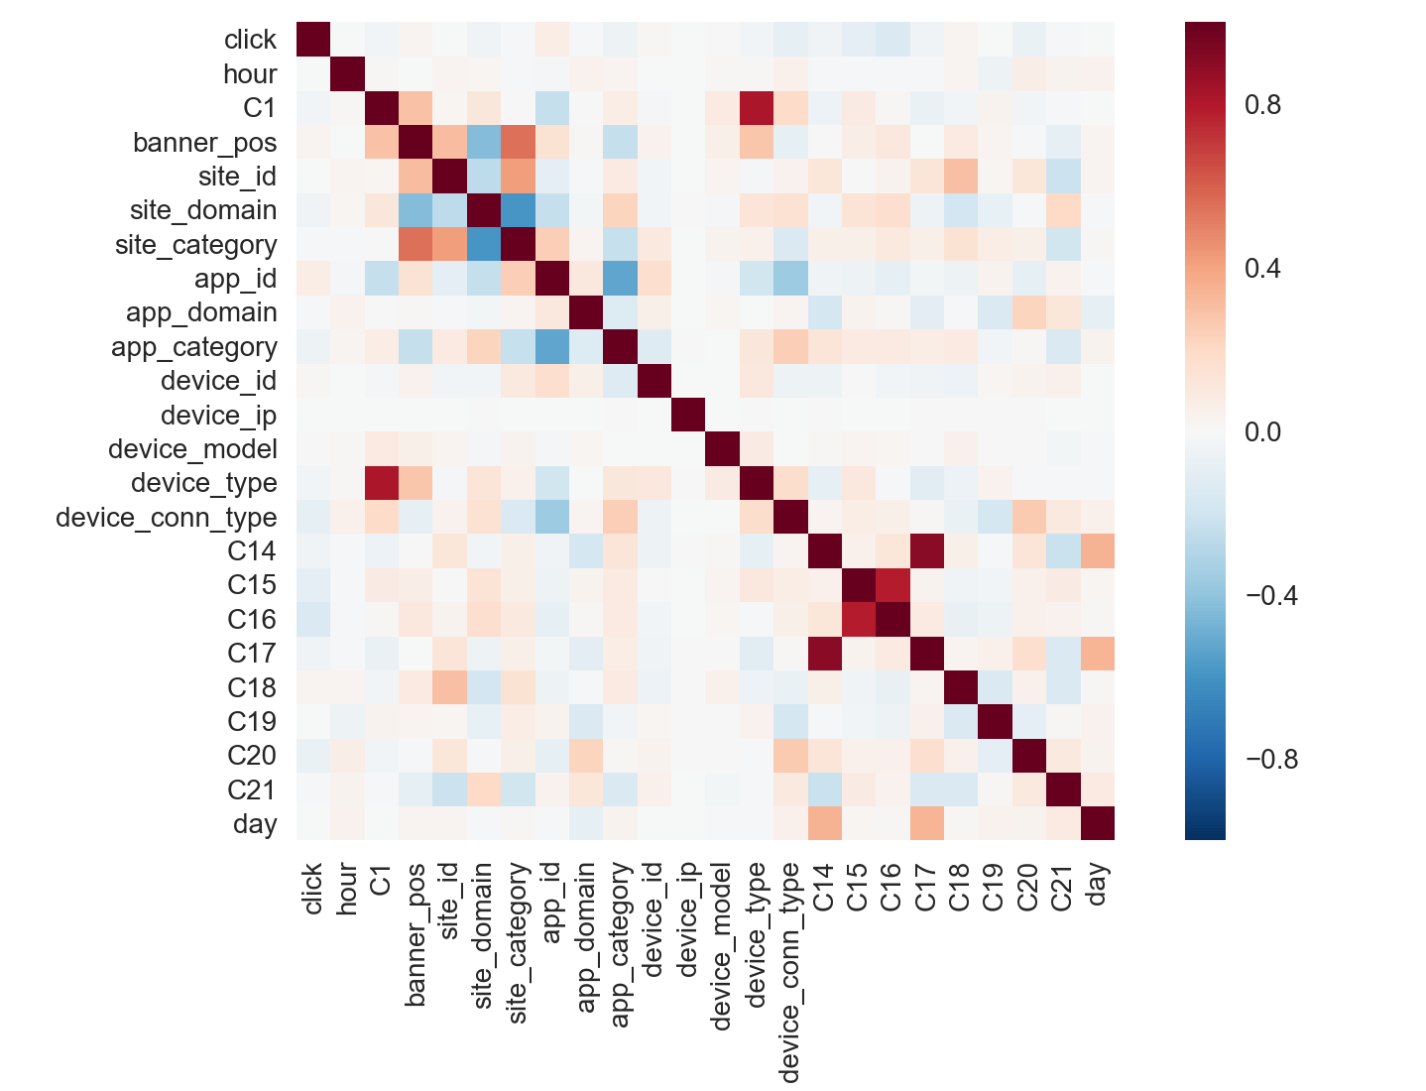
INTERPRETATION OF THE MODEL OUTPUTS-2
If we look at the feature heat-map, there is a high correlation on the following pairs:
1. C1 : Banner position
2. Site id: Banner position
3. Site category: Banner position
4. C1: Device type
5. C15: C16
6. C14:C17
On the other hand, following pairs are negatively correlated:
Site domain: Banner position
Site domain: Site category
App category: App id

Slide 10
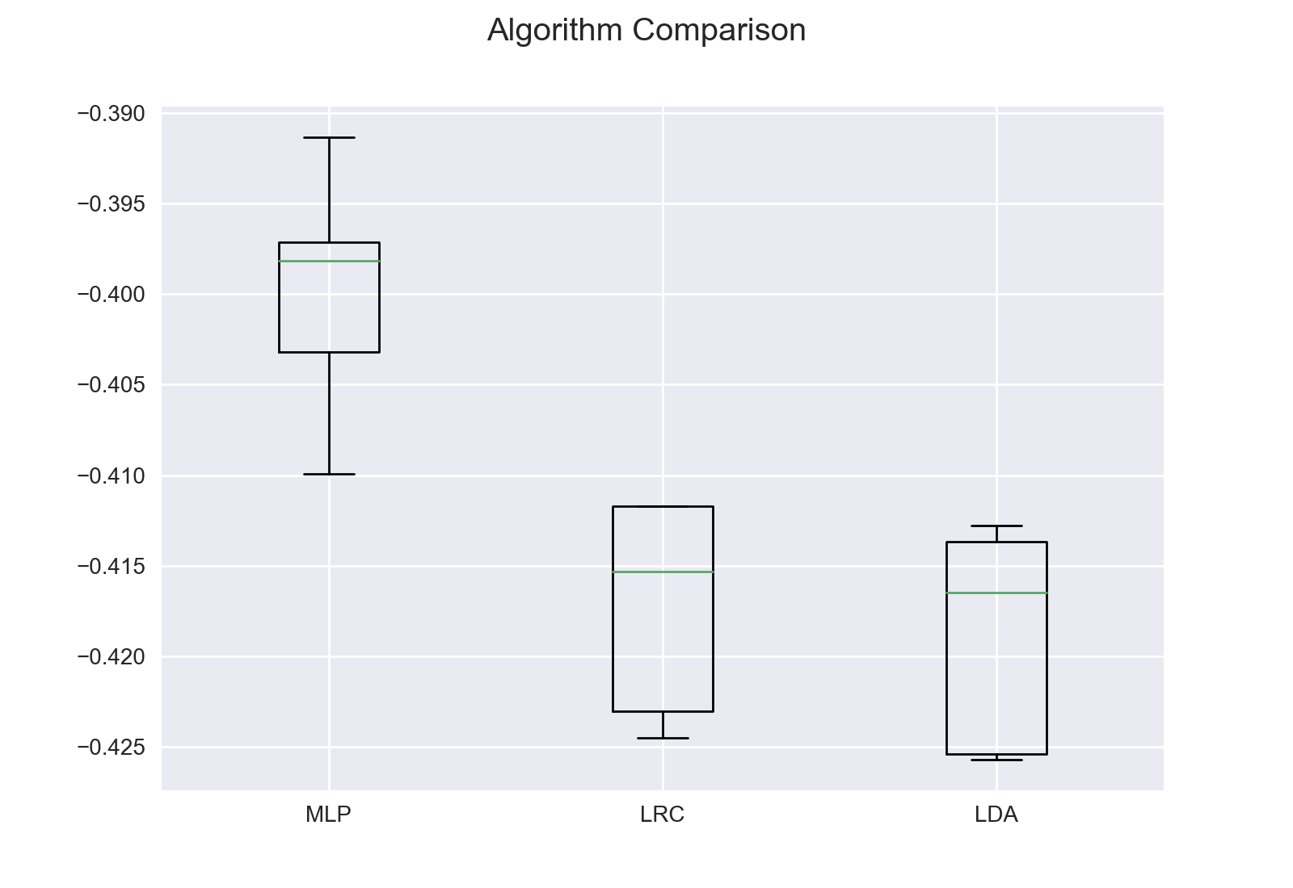
MODEL VALIDATION-1
As seen on the left figure, 5-fold cross validation on different models shows that Multilayer Perceptron (MLP) outperforms rest of the models. Logistic Regression Classifier and Linear Discriminant Analysis follow the MLP

Slide 11
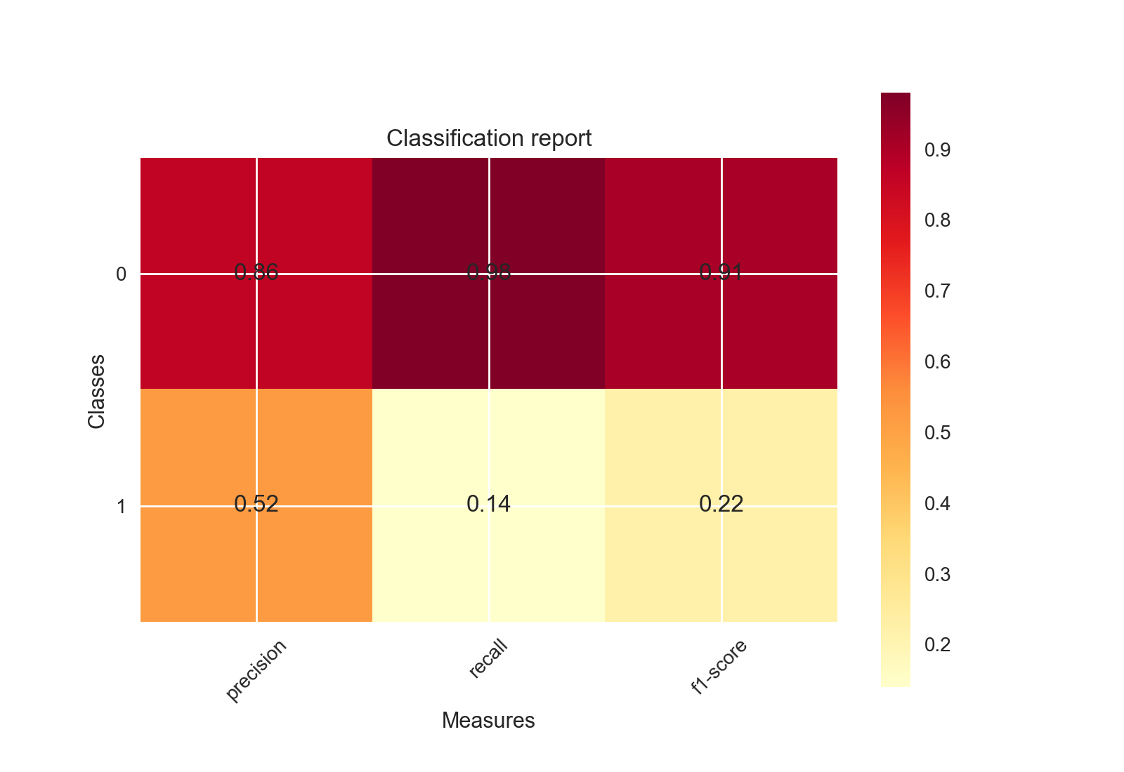
MODEL VALIDATION
By using MLP, we have reached following average prediction values:
Log-loss: 0.402979(+-0.002565) on training data
Log-loss: 0.392031 on test data
Precision: 0.81, Recall: 0.85 F1-measure: 0.81
On the other hand we observed that the calibration with validation data after model training does not always improve the prediction performance on this dataset.

